Slide 1
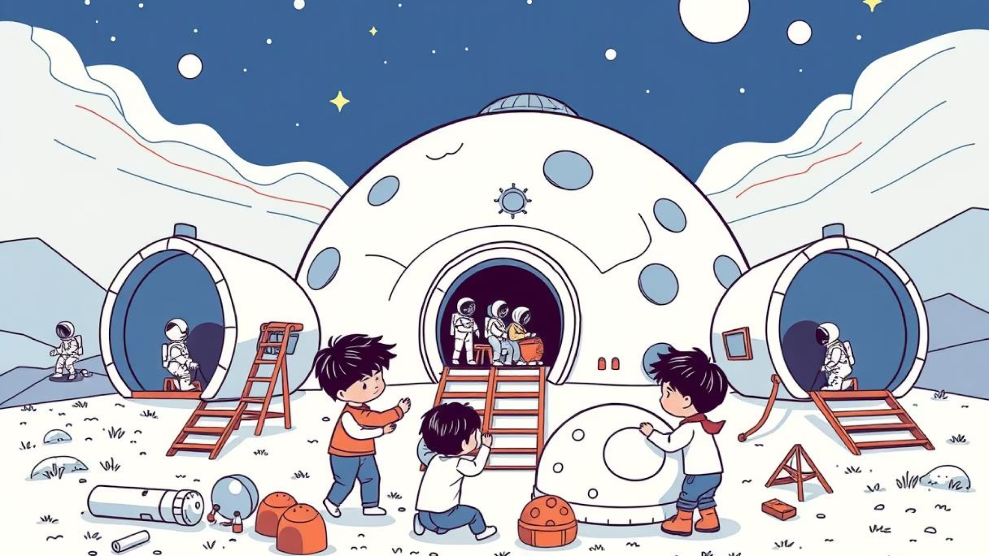
Lunar Base Construction
Lesson 5: Coding Your Base
Notes:
https://edu.delightex.com/QBH-BED

Slide 2
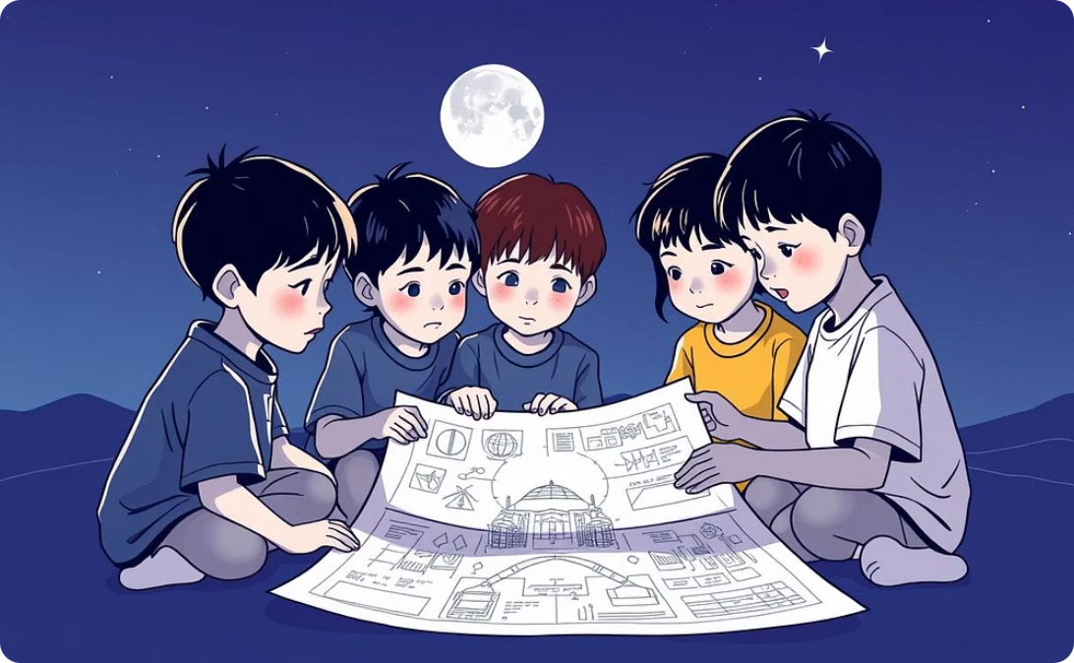
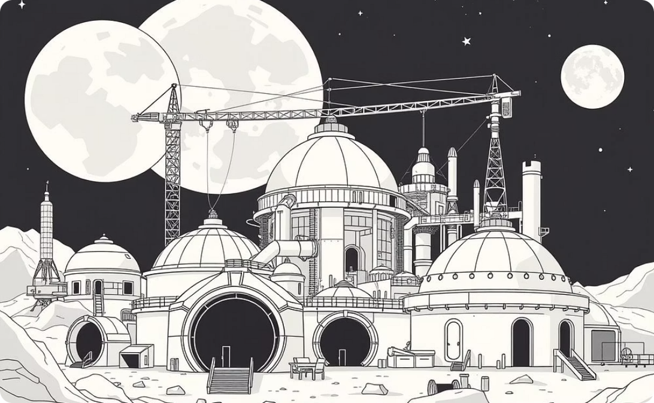
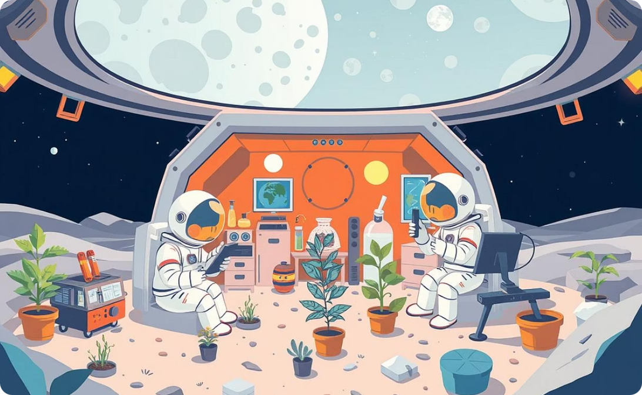
Lesson Objectives: Building Your Lunar Home
Analyze & Connect
Build Your Base
Bring it to Life
https://edu.delightex.com/QBH-BED
Notes:
https://edu.delightex.com/QBH-BED
Understand the components and structure of a completed space base.
Design and create your unique base using domes, tubes, and airlocks.
Add characters and animate their movements within your lunar base design.

Slide 3
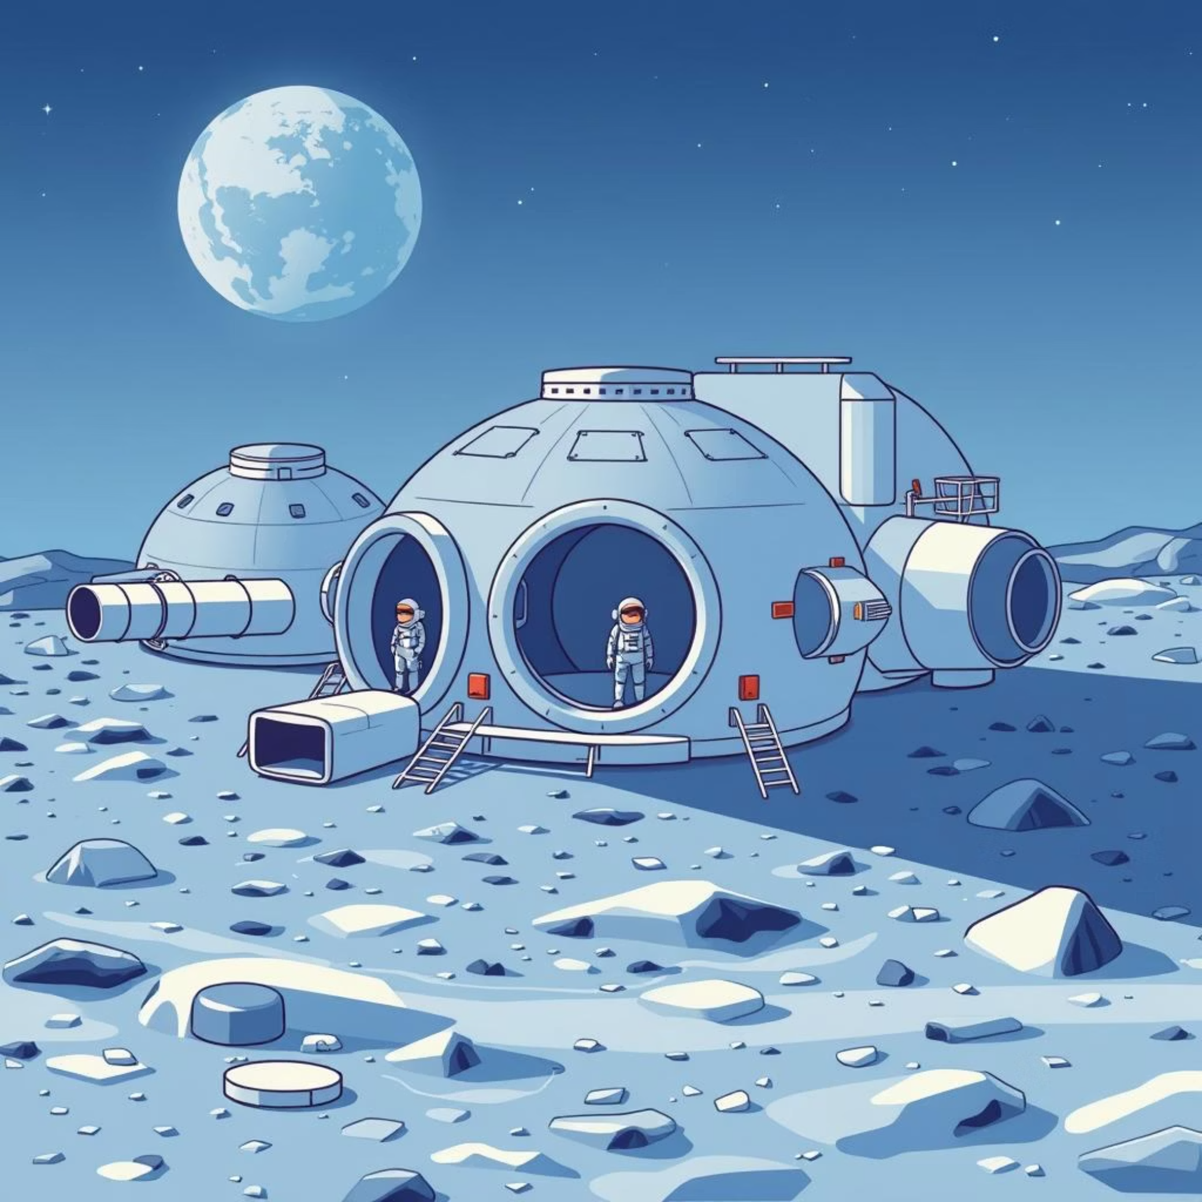
Inside a Lunar Base: Teacher's Example
https://edu.delightex.com/QBH-BED
What to Notice:
Domes (different colors!) connected by tubes.
Airlock doors for safe entry and exit.
Astronauts (characters) making the base busy.
Everything flows logically, like a real building!
Your Starter Kit Has:
Domes, tubes, and airlock doors.
Button groups and a camera.
You just need to add the characters!

Slide 4
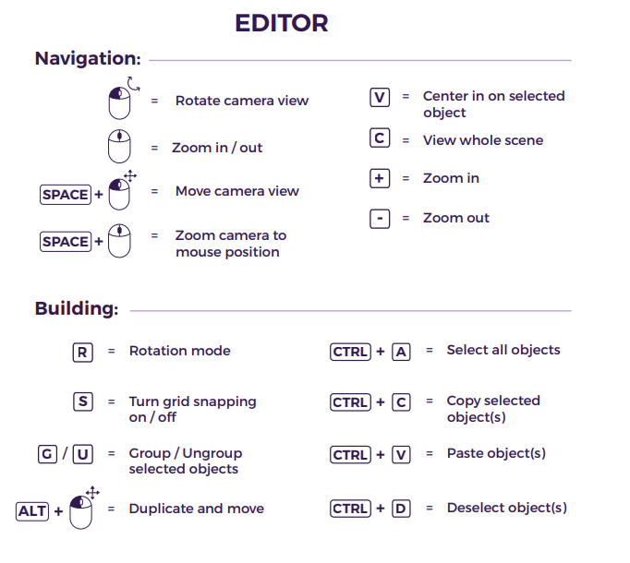
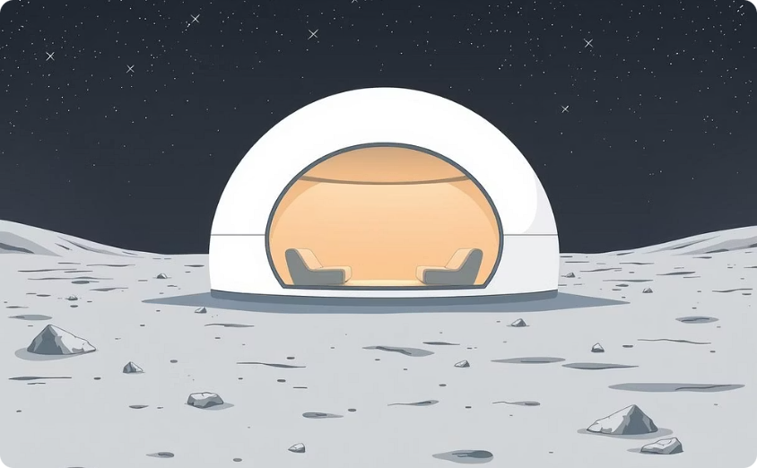
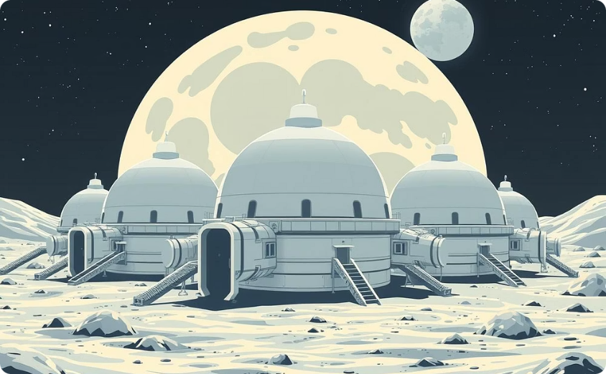
Your Core Mission: Build Your First Lunar Base!
Start with One Dome
Add Tubes & More Domes
Begin by placing a single dome.
This will be the main living area for your astronauts, providing essential shelter.
Expand your base by adding tubes
This creates corridors and connect multiple domes, forming new functional areas.
when program starts move Regular_man on path Round_path in 120 sec forever set gravity pull to 0.17
Remember: Your base should be uniquely yours!
Notes:
https://edu.delightex.com/QBH-BED
Model to children how to copy and paste, translate, resize, add 3D objects
TopTip - Show children how to lock or unlock items - stops accidentally moving objects - will have to unlock if they want to resiz e

Slide 5
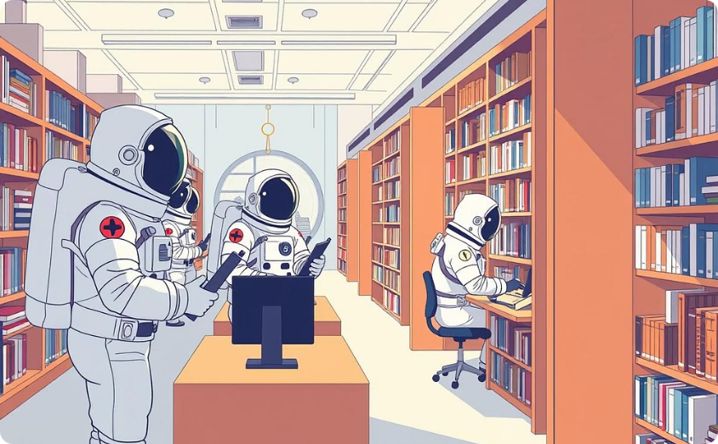
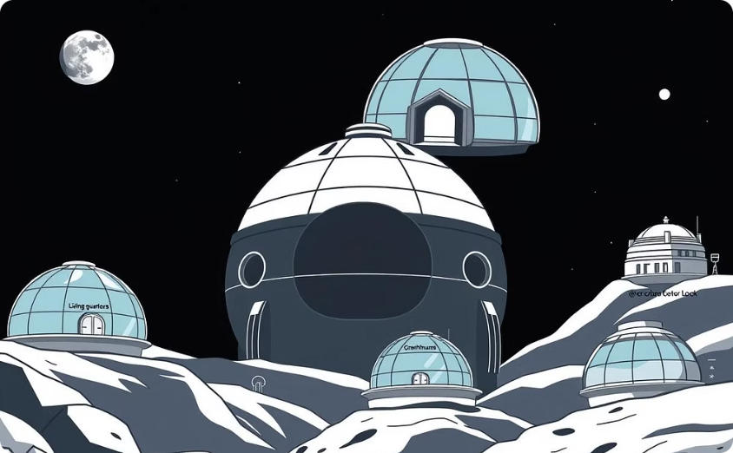
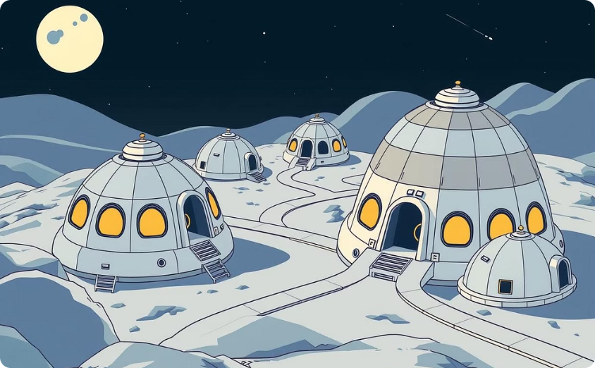
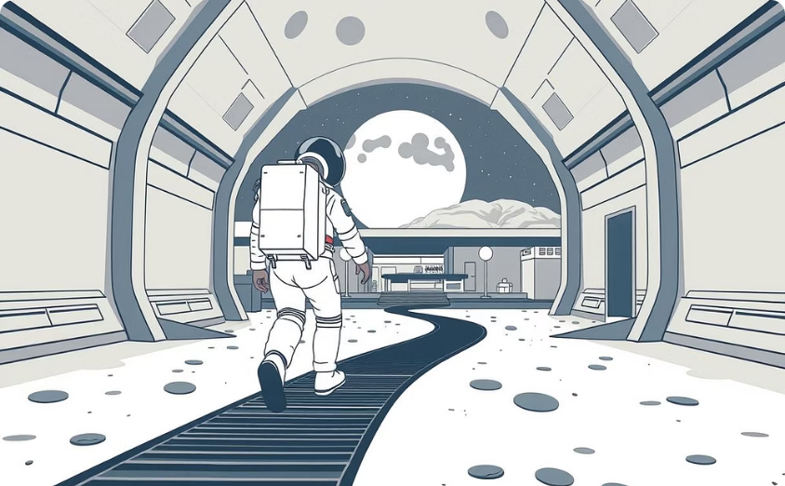
Time for a Quick Check-in!
Characters Added?
Character Animations?
Domes with Purpose?
Clear Connections between additional domes
If you answered YES to most, great job! You're ready for more fun!
Notes:
Have you assigned a clear purpose to each dome in your base?
Did you successfully add characters from the library to populate your base?
Is your astronaut moving smoothly around a path you've set?
Do different parts of your base link up easily, forming clear pathways?

Slide 6
Mild Challenge: Your First Steps on the Moon
Mission: Build a safe and functional home for one astronaut.
What You Need:
1 main habitat dome
1 airlock door
1 character + animation
Success Looks Like: A secure living area with a clear entrance.
Hot Challenge: Expanding Your Lunar Outpost
Mission: Create a base with different areas for living and working.
What You Need:
2 domes (e.g., living & lab)
Tube connectors
2 airlock doors
2-3 characters placed around
Success Looks Like: Connected areas, multiple entry points, and characters doing different tasks.
Spicy Challenge
Mission: Design a large, advanced lunar city with many specialized areas.
What you need to build:
At least three domes, each with a different color and function.
A detailed network of tubes connecting the domes.
Many airlocks placed in smart locations.
Multiple characters with unique jobs.
Bonus: Characters that follow custom patrol routes.
Goal: Create an advanced, interactive, and professional-looking lunar city.
Notes:
Top Tip
Might have to remind children how to set Animation - This can be done without code - Right Clight animation

Slide 7
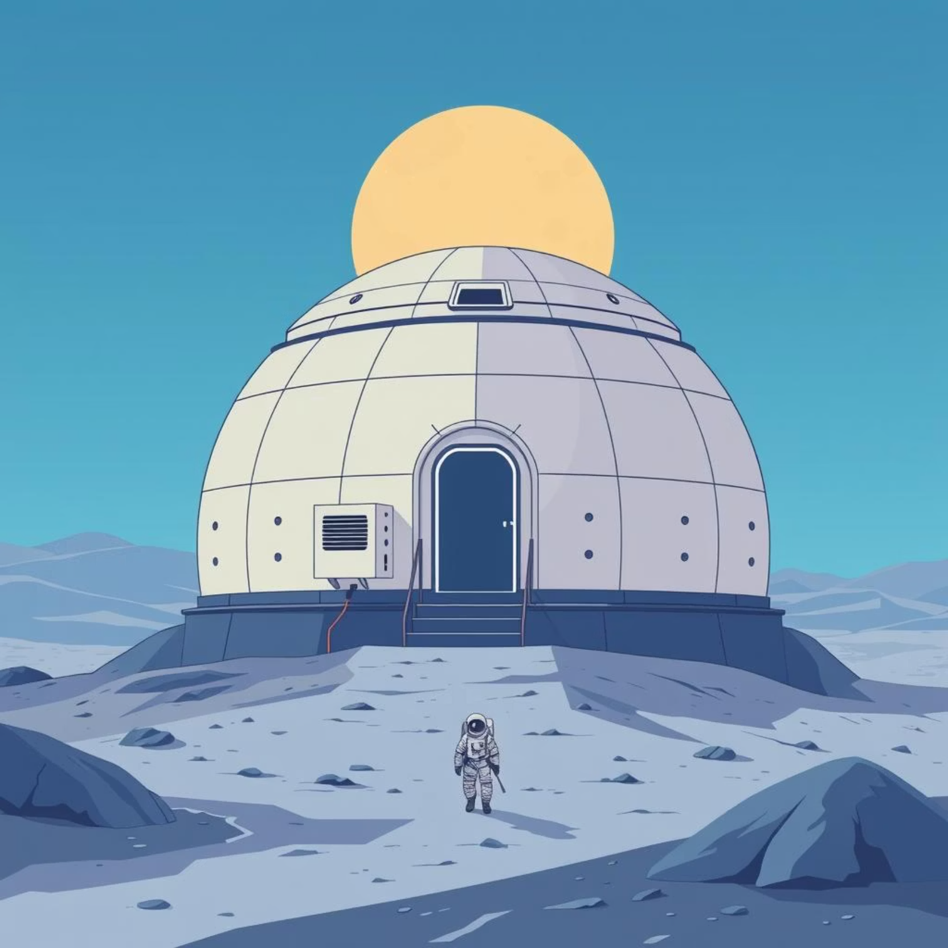
Mild Challenge: Your First Steps on the Moon
Your Mission: Build a safe and functional home for one astronaut.
What You Need:
1 main habitat dome
1 airlock door
1 character patrolling a path
Success Looks Like: A secure living area with a clear entrance.
Perfect for getting the basics right!

Slide 8
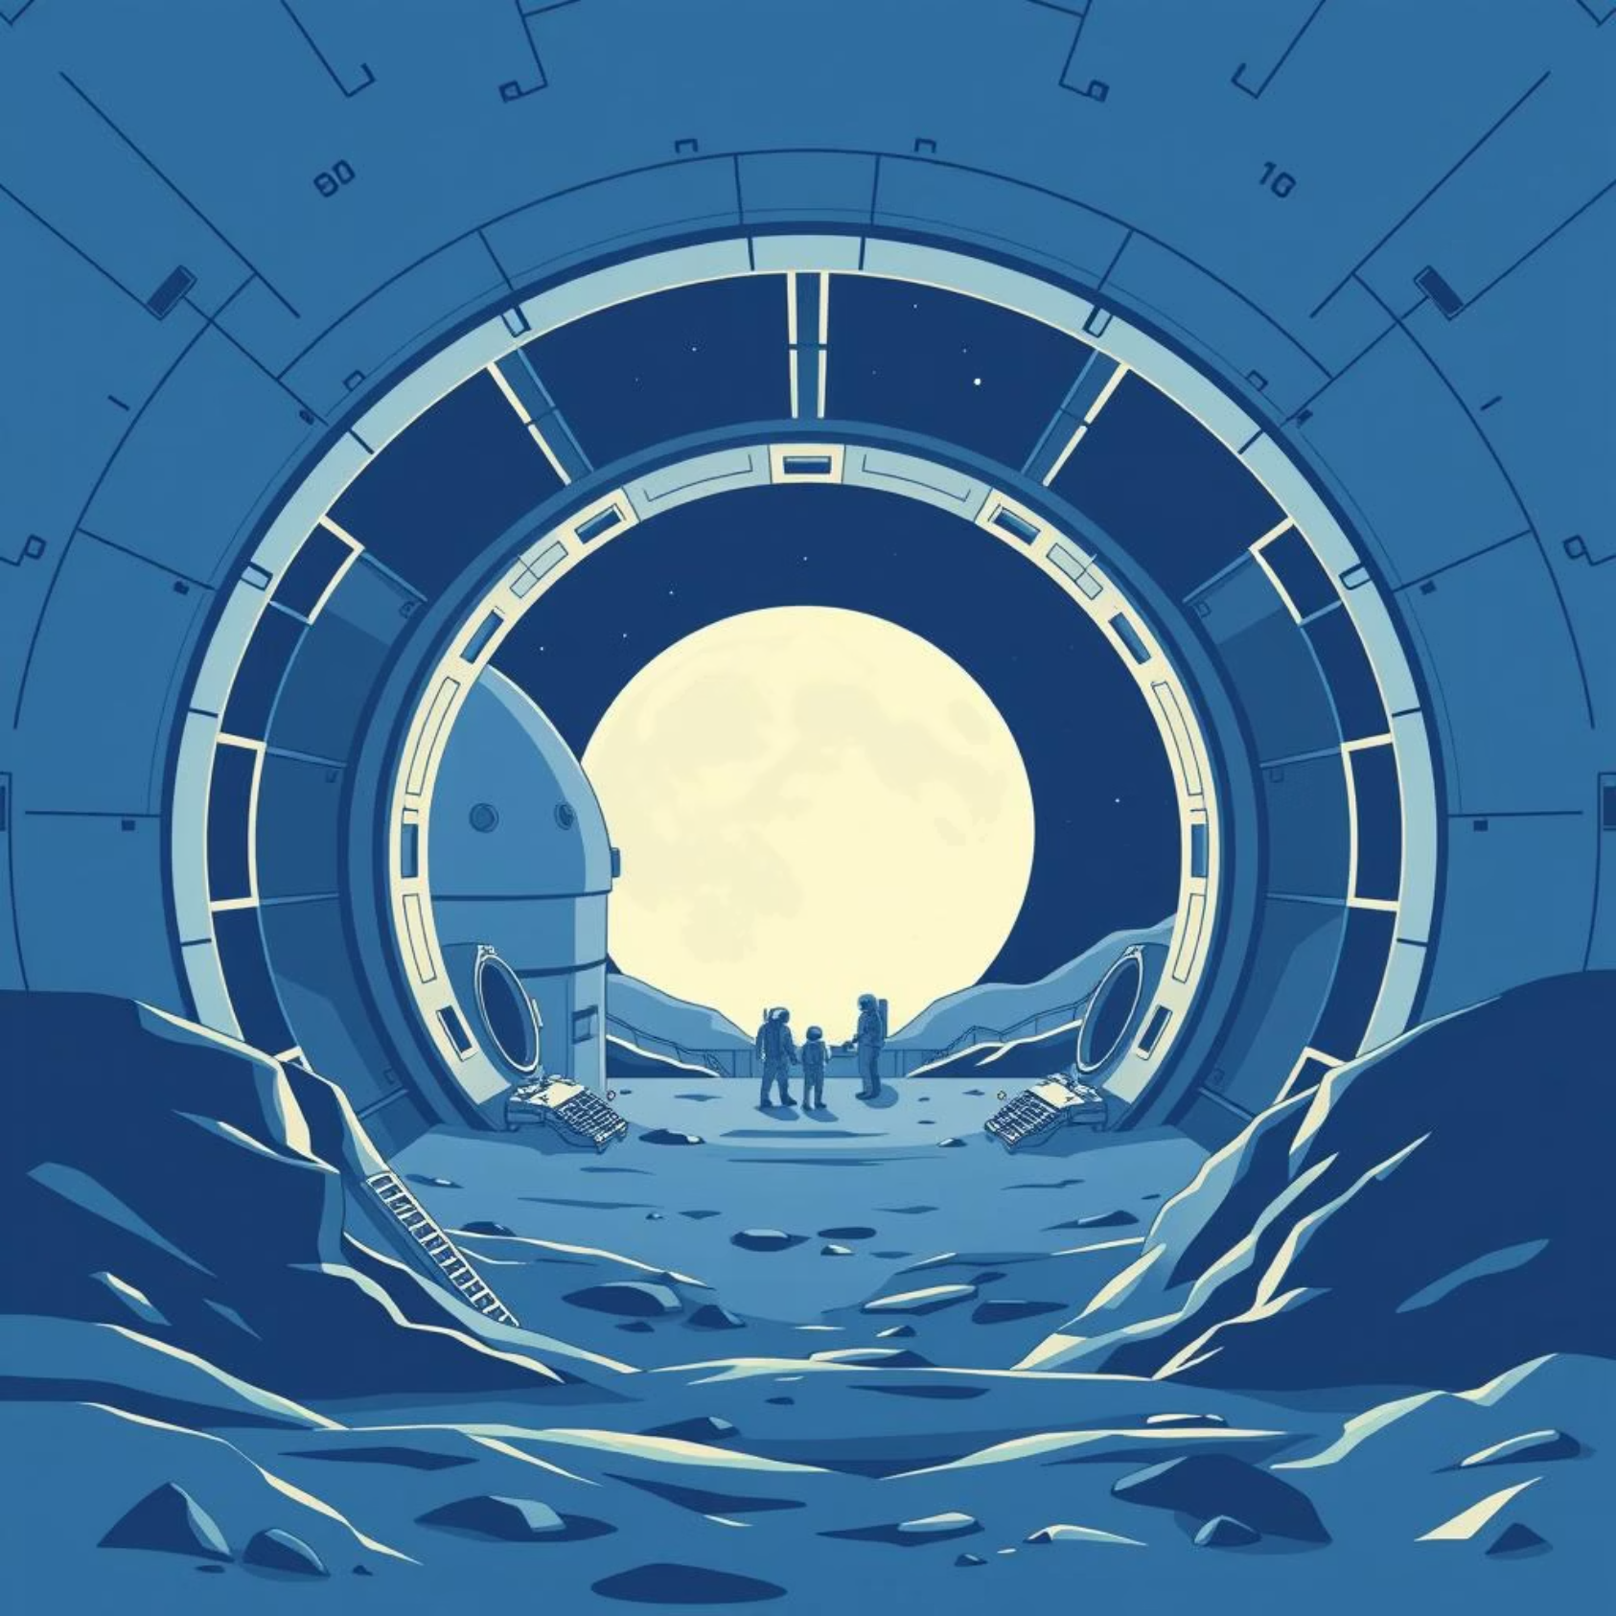
Intermediate Challenge: Expanding Your Lunar Outpost
Your Mission: Create a base with different areas for living and working.
What You Need:
2 domes (e.g., living & lab)
Tube connectors
2 airlock doors
2-3 characters placed around
Success Looks Like: Connected areas, multiple entry points, and characters doing different tasks.
Perfect for building more complex structures!

Slide 9
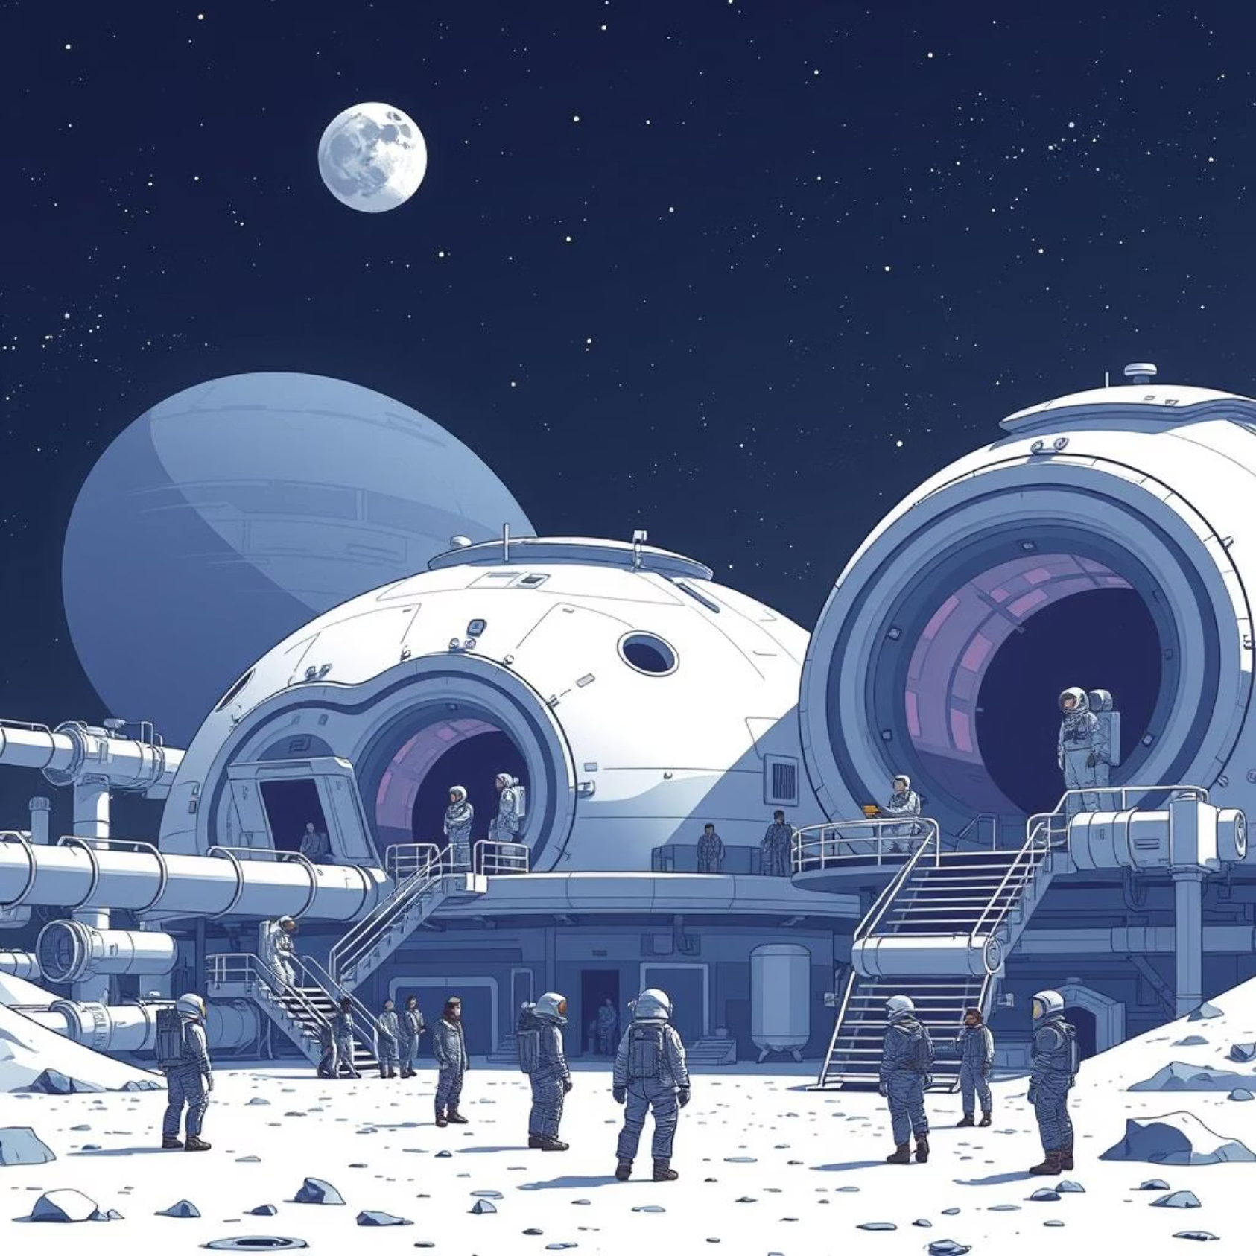
Advanced Challenge: Design a Lunar City!
Your Mission: Design a super-cool lunar settlement with many specialized areas!
What You Need:
3+ domes, each with a unique color and purpose
A complex network of tubes
Many strategically placed airlocks
Multiple characters with different jobs
Bonus: Custom patrol paths!
Success Looks Like: A professional, innovative, and interactive lunar city!
Perfect for pushing your design skills to the limit!

Slide 10




Fantastic Work, Space Engineers!
Built Amazing Bases
Used Smart Thinking
From scratch!
Created Real Habitats
Brought Bases to Life
You proved that big things can be built from small parts – just like real engineers!

Slide 11
Ready for Your Next Mission?
Interactive Doors
Gravity Zones
Make your buttons actually open and close doors.
Add different gravity levels to your base areas.
Realistic Movement
Interactive Systems
Program characters to move even more realistically.
Create systems that react when astronauts click them!
Keep your base safe, because next time, we make it interactive!
Well Done, Future Space Explorers!

